Slide 1

Using Machine Learning and AI to Predict Eligibility, for Rental Assistance, in FEMA Programs.
Department of Data Science, Saint Peter’s University

Slide 2
Fema - Federal Emergency Management Agency
FEMA provides three programs for Individual Assistance (IA) and Public Assistance (PA), alongside its Hazard Mitigation Assistance (HMA) program.
The smallest annual amount FEMA spent was $2 billion (in 1992), and the largest was $47 billion (in 2020).
On average over the 30-year period, spending was roughly $12 billion a year.

Slide 3
challenges
FEMA's struggle in accurately determining rental assistance eligibility, potentially streamlining the allocation process
Delays in processing applications for assistance programs
FEMA encounters difficulties in effectively distributing funds across its assistance programs, posing challenges in allocation.
FEMA struggles with accurately tracking and responding to the changing needs of disaster survivors over time, posing a significant challenge for resource allocation.

Slide 4

Machine Learning Solution for FEMA's Assistance Program Challenges
Utilizing machine learning for predictive rental assistance eligibility assessment reduces processing time.
Automated eligibility determination streamlines aid distribution, minimizing delays.
Predictive modeling enhances FEMA's ability to adapt and respond to changing disaster survivor needs.
Efficient resource allocation ensures timely and targeted assistance to affected individuals and communities.
Improved response mechanisms increase FEMA's overall effectiveness in disaster relief efforts.

Slide 5
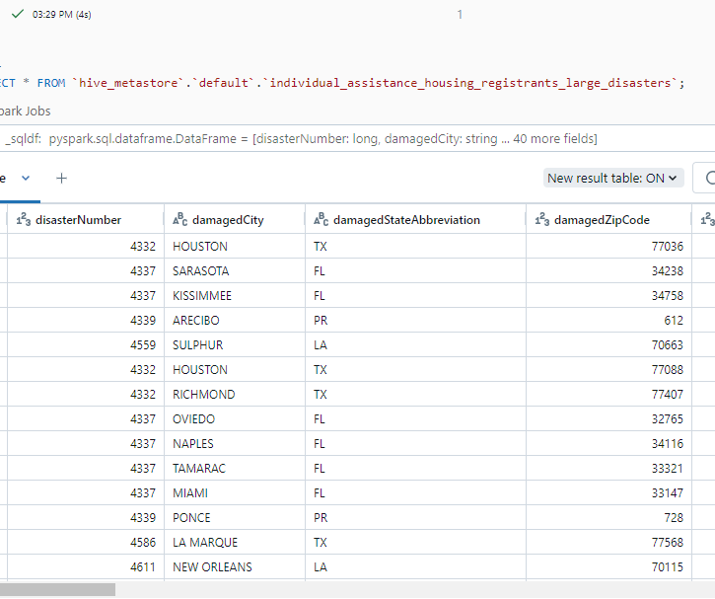
Data Collection & Overview
The data is imported from FEMA open source(OpenFEMA) which has 6.3 million rows and 42 columns.(https://www.fema.gov/openfema-data-page/individual-assistance-housing-registrants-large-disasters-v1)

Slide 6
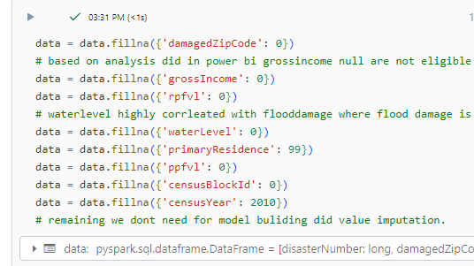
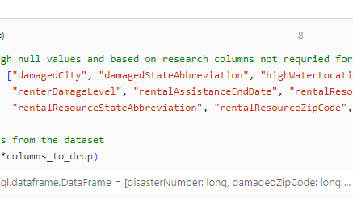
Data Pre-processing
Checked and removed Null points ,added new column, Outliers, Value Imputation, String to Numerical(label encoding )

Slide 7
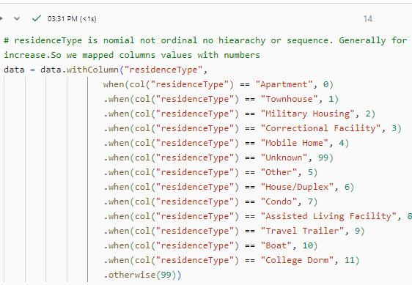
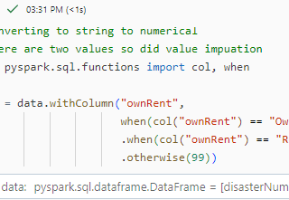
Data Pre-processing
Label encoding

Slide 8
Feature Engineering
Feature selection methods
Project Research
Correlation
Chi-square selector
Feature Importance

Slide 9
Feature Selection
Based on my research below are independent variables to predict rental Assistance Eligible
Independent variables – household Composition, gross Income, special Needs, own Rent, residence Type, homeowners Insurance, flood Insurance, inspected column, habitability Repairs Required, destroyed, water Level, flood Damage, foundation Damage, roof Damage
Dependent variable -rental Assistance Eligible

Slide 10
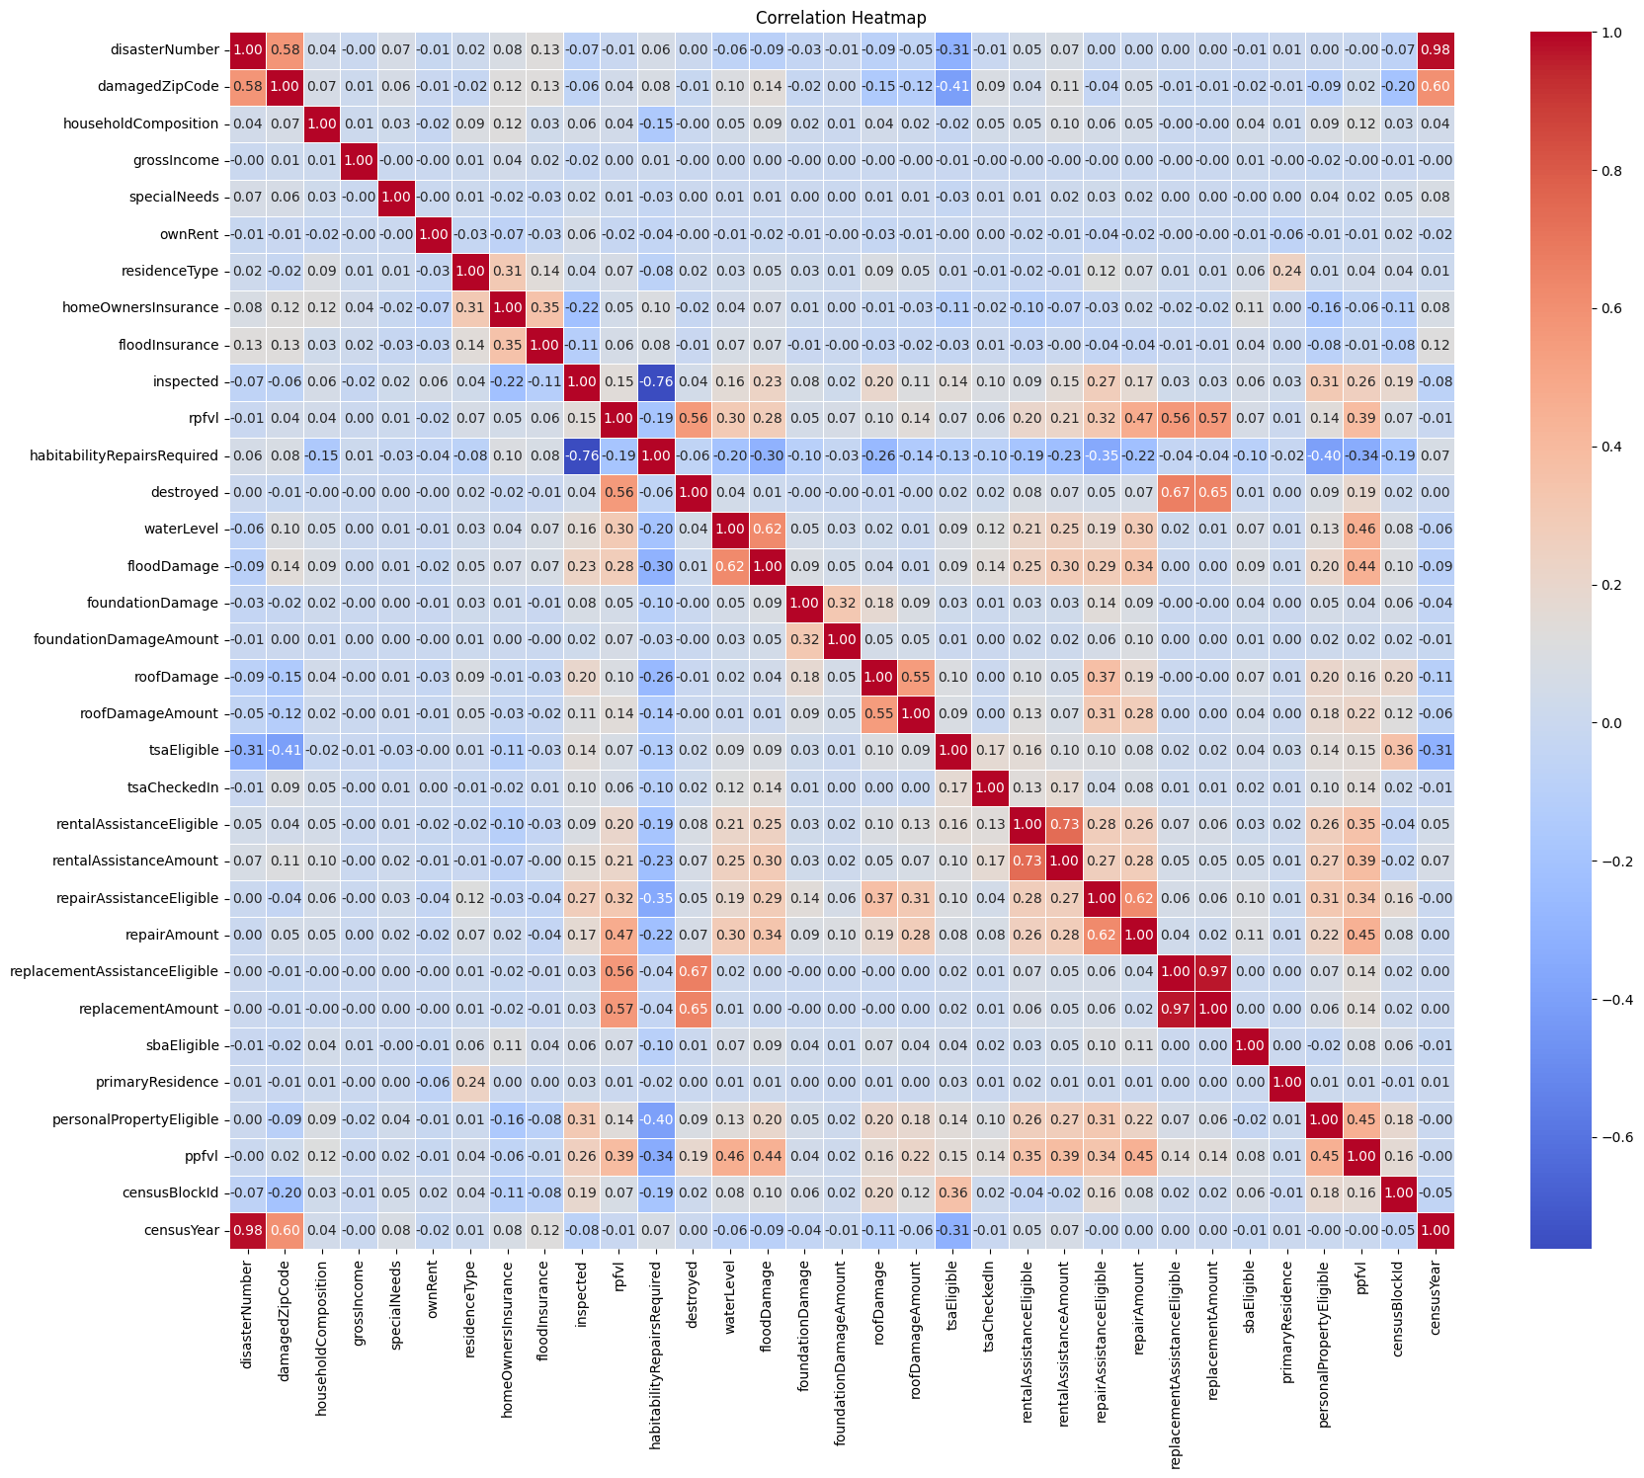

Slide 11
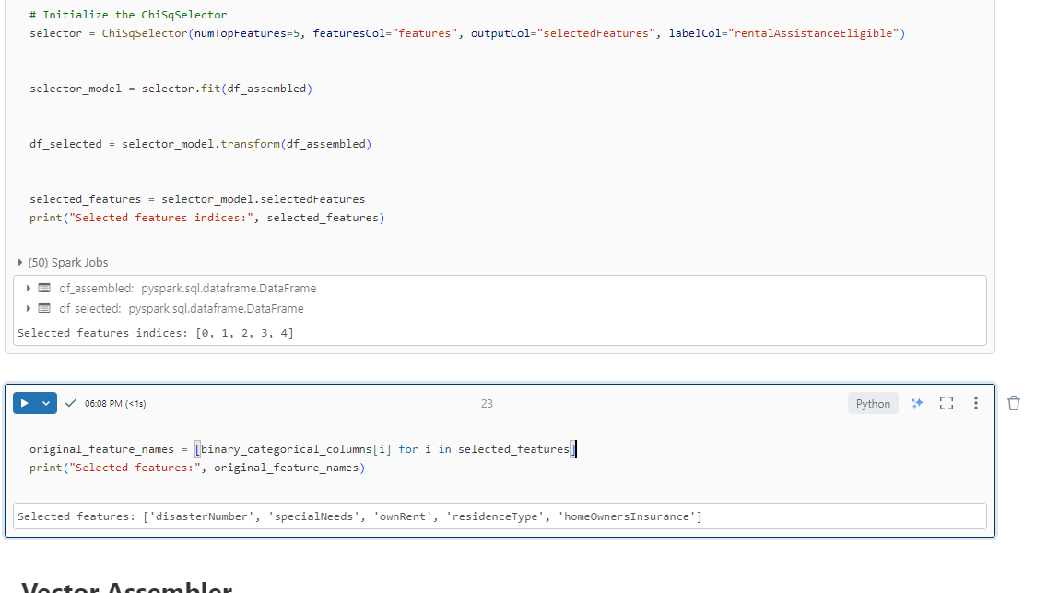

Slide 12

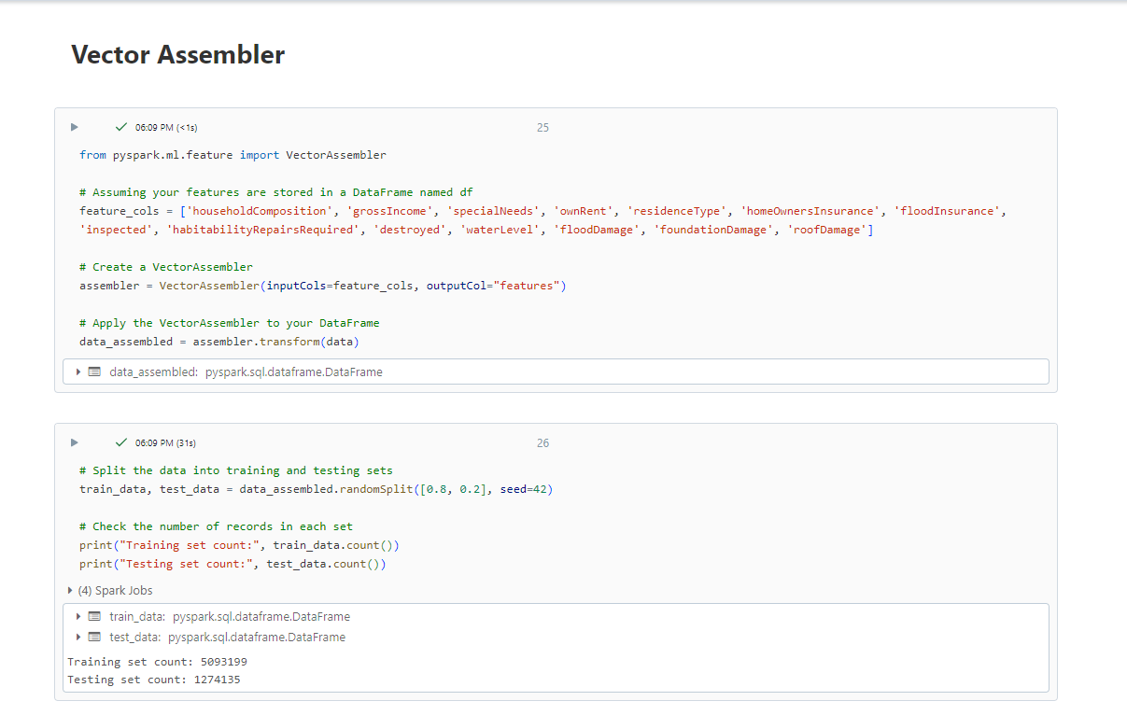
MoDEL Buliding

Slide 13
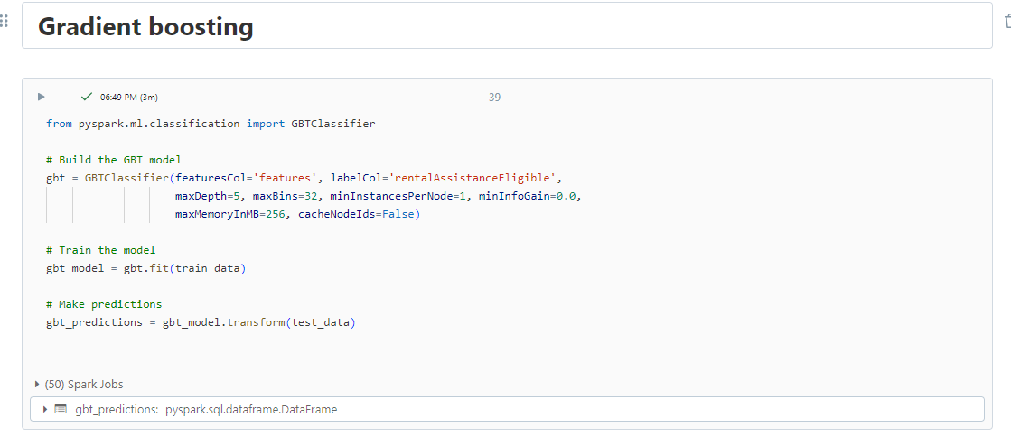
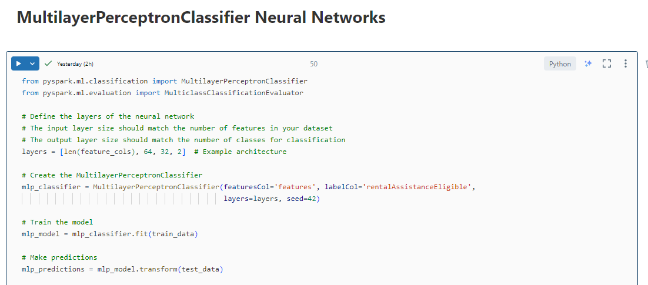
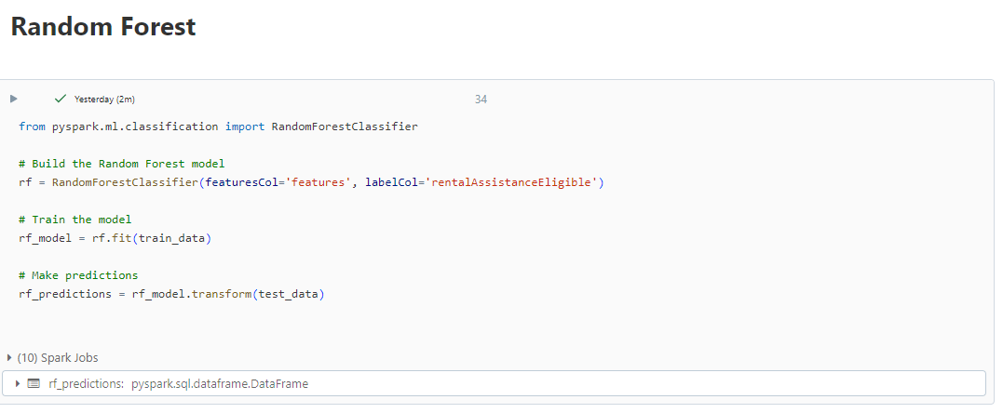
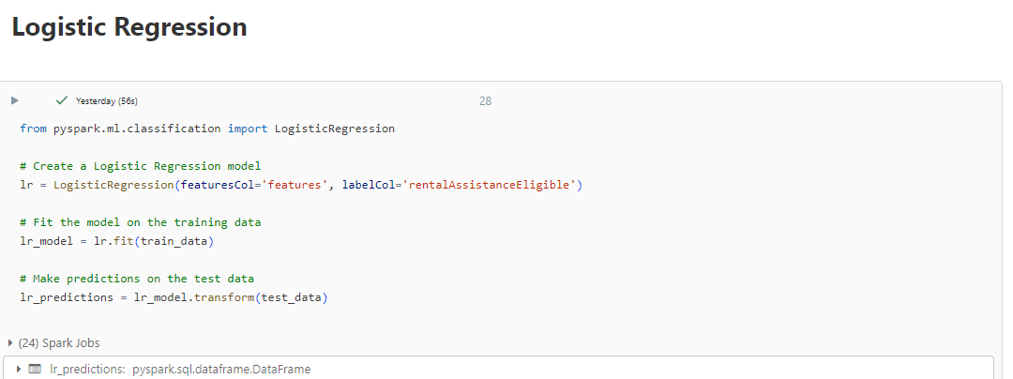

Slide 14
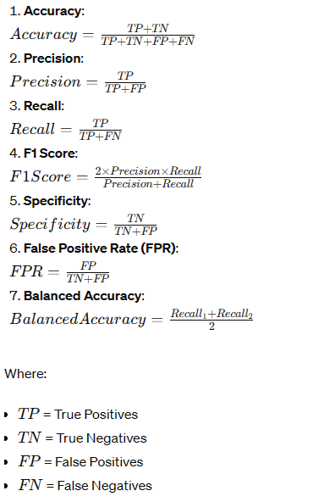
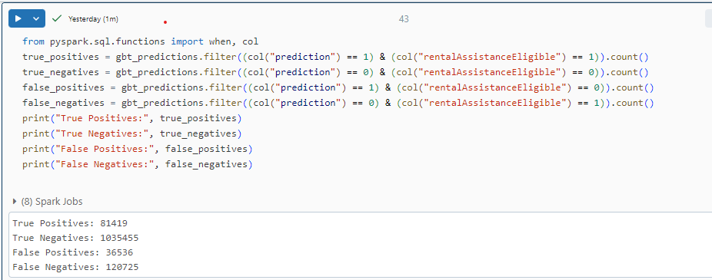

Slide 15
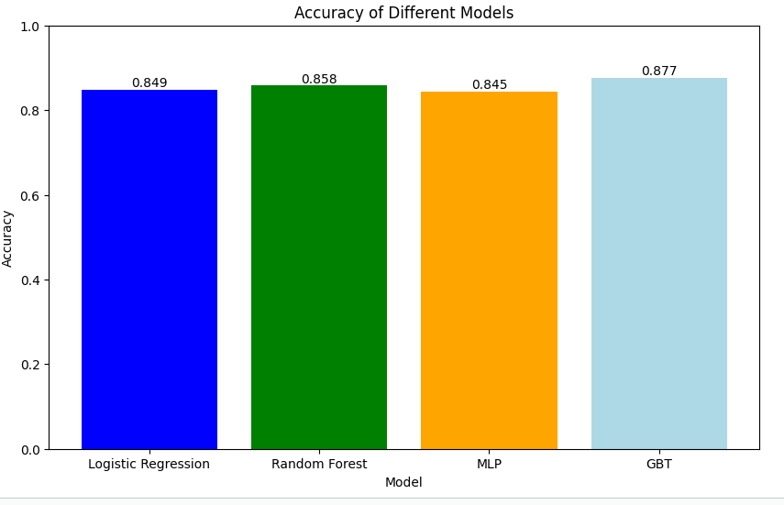

Slide 16
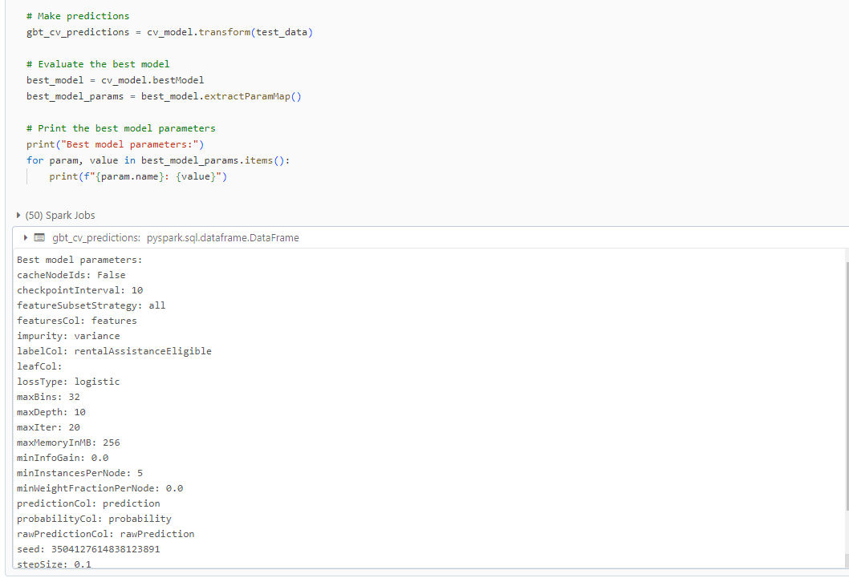
Hyperparameter

Slide 17
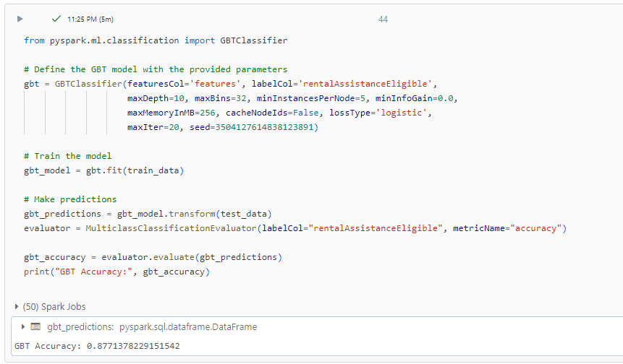

Slide 18

Conclusion -
By utilizing the Gradient Boosted Tree (GBT) model trained on data from disaster survivors, we've successfully developed a predictive tool for assessing the eligibility of their applications.
This model provides insights into whether applicants are eligible for assistance, aiding in the efficient allocation of resources during post-disaster recovery efforts.
Looking ahead, we aim to enhance our disaster response capabilities by incorporating machine learning and artificial intelligence (AI) technologies. By leveraging these advanced technologies, we seek to predict and anticipate future disaster occurrences more effectively. This proactive approach will enable us to better prepare for and mitigate the impact of disasters, ultimately improving our overall disaster management and response strategies.

